Slide 1
Patient Information System
By SQL-Injectors
Group No-9
Prof: Vincent R Lattuada
Subject: Data Management & Database Design

Slide 2
Toad Model For Patient Information

Slide 3
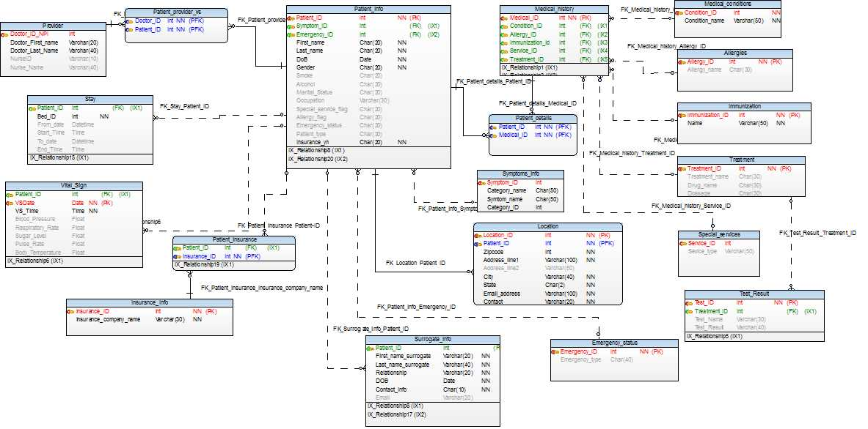

Slide 4
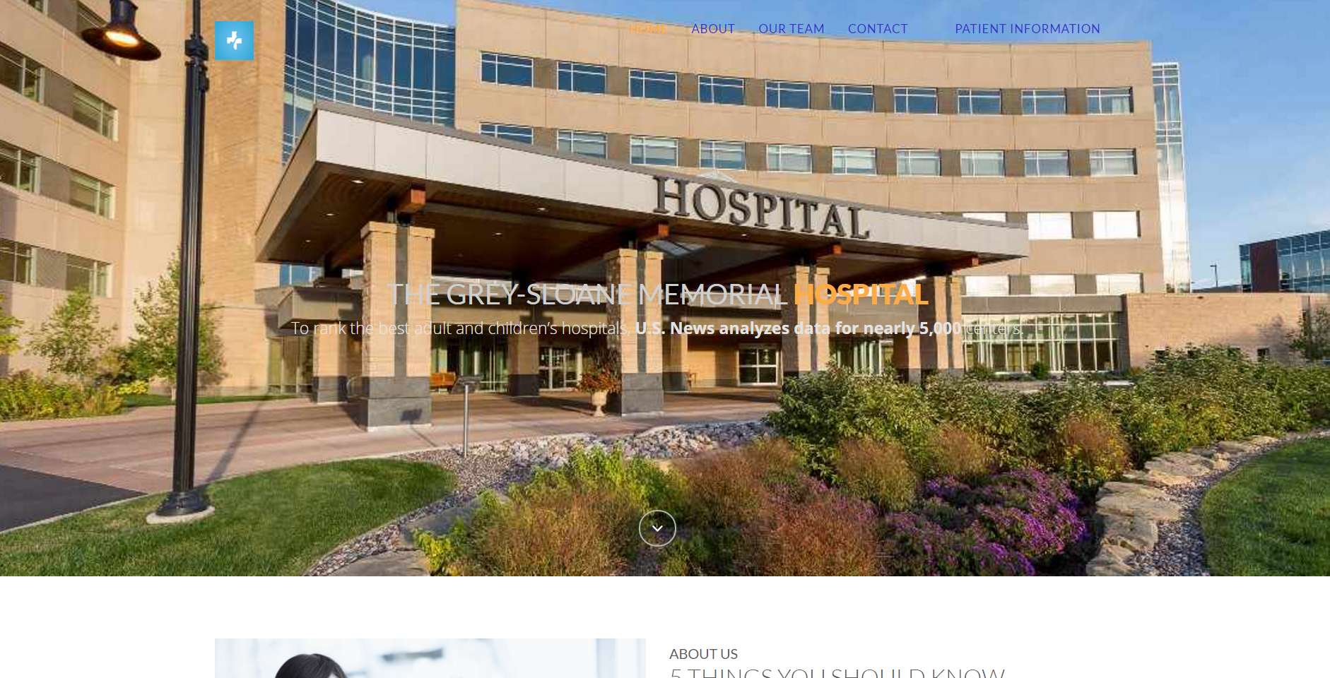
Home-Page for The Grey –Sloane Memorial Hospital

Slide 5
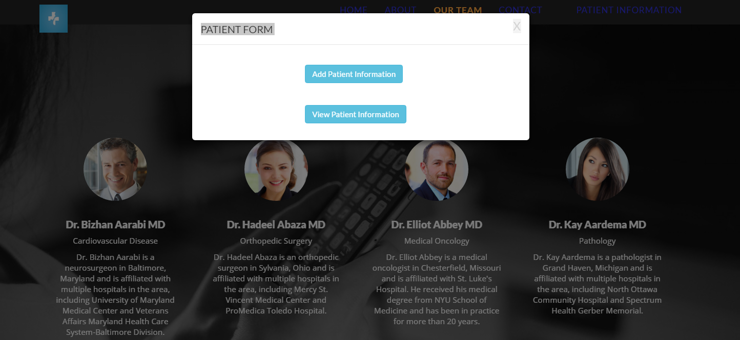
Patient Information:

Slide 6
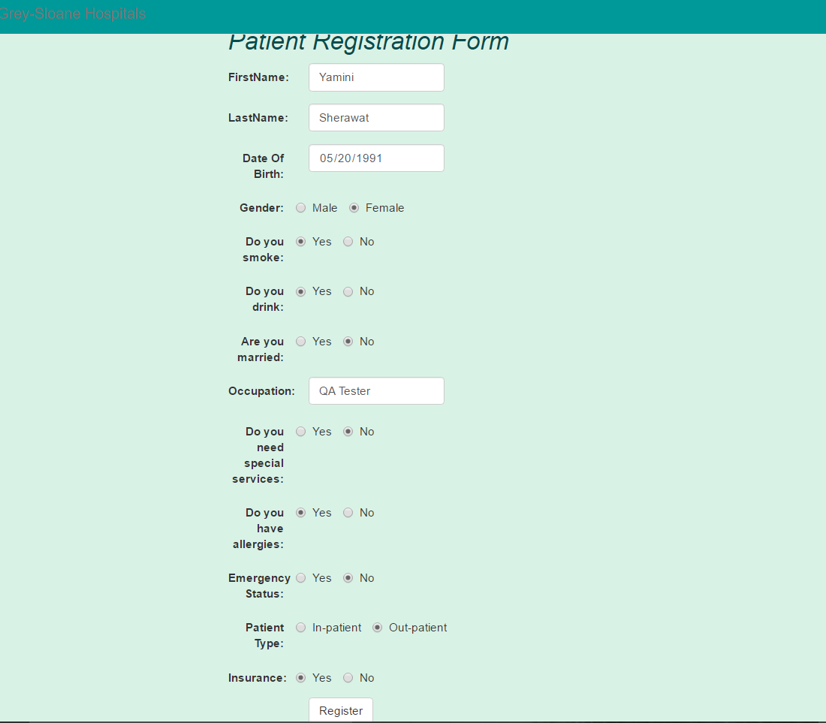
Patient Registration Form:

Slide 7
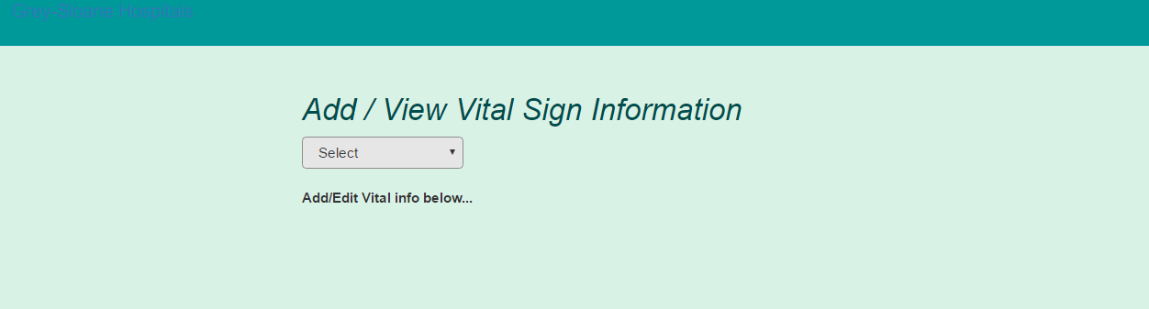
Add/View Vital Sign Information

Slide 8
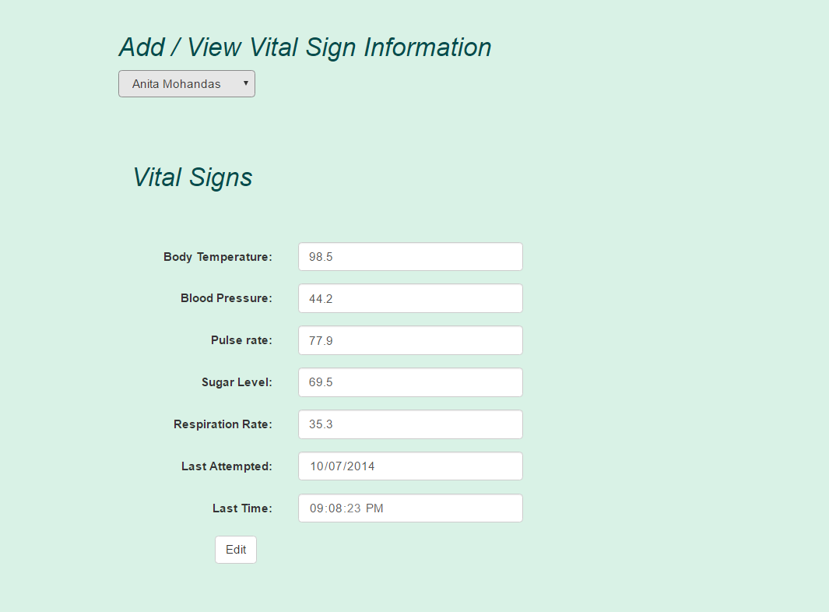
Add/View Vital Sign Information

Slide 9
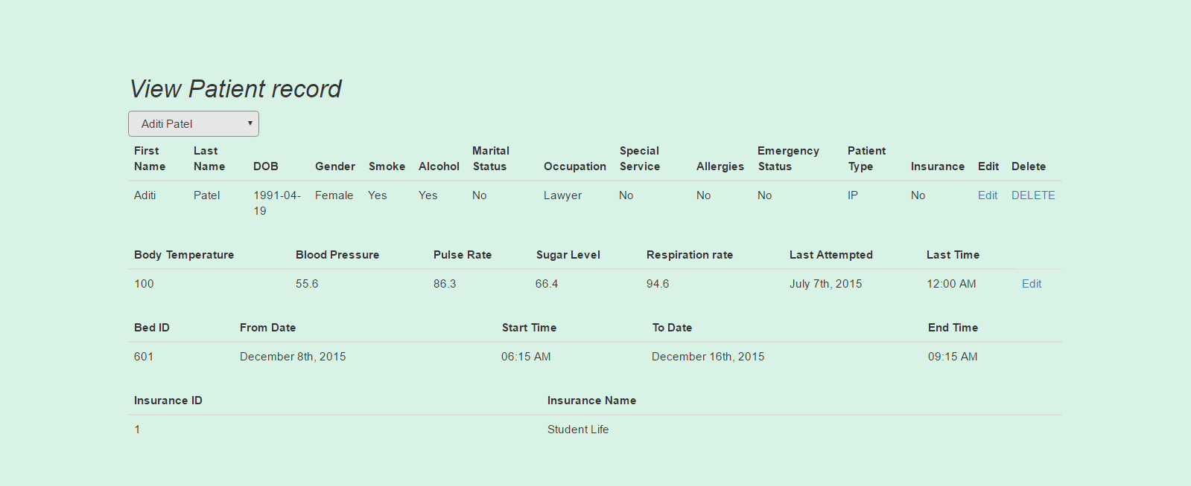
View Patient Record for In-Patient

Slide 10
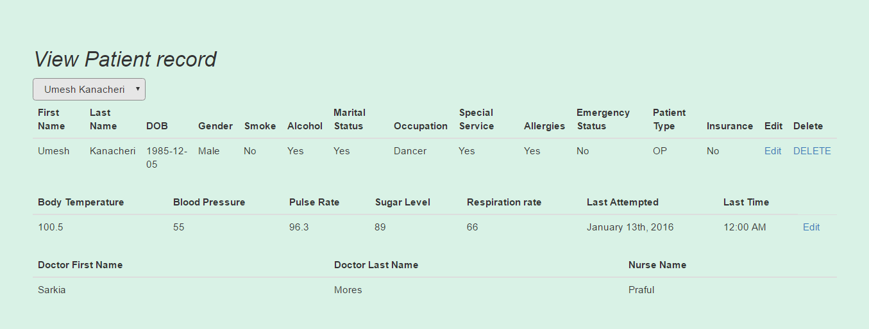
View Patient Record for Out-Patient

Slide 11
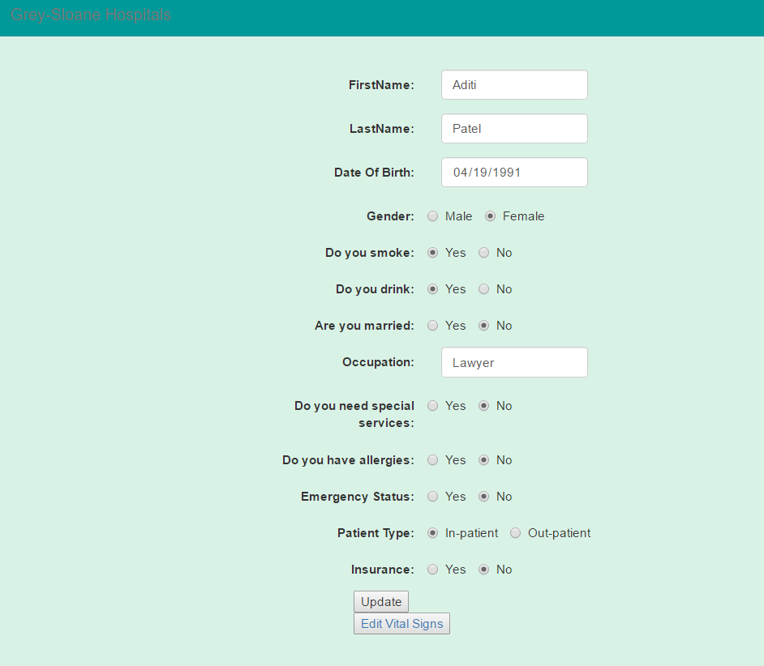
Edit/Update Information

Slide 12
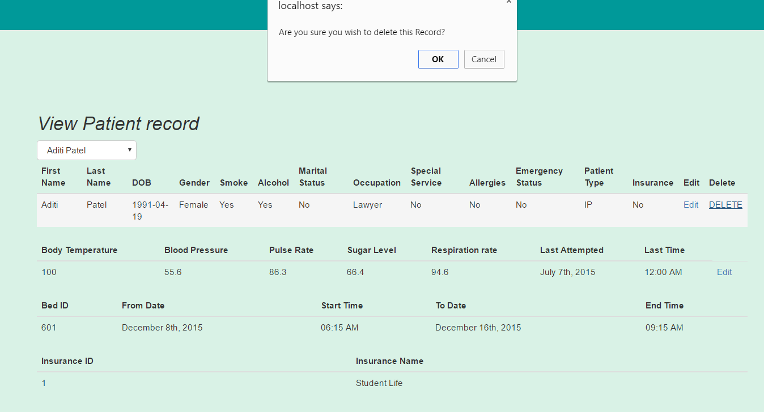
Delete a Record

Slide 13

THANK YOU
By-SQL INJECTORS
Group-09

